Slide 1
2020
Milton Pony Club
Ride with Pride!
Notes:
This presentation demonstrates the new capabilities of PowerPoint and it is best viewed in Slide Show. These slides are designed to give you great ideas for the presentations you’ll create in PowerPoint 2011!
For more sample templates, click the File menu, and then click New From Template. Under Templates, click Presentations.

Slide 2
Pony Club Structure
National Office
Region
  Ours is South Region and covers Georgia and southern half of Alabama
  Led by “Regional Supervisor” (RS)
Club
  Ours is Milton Pony Club
  Led by “District Commissioner” (DC) AND VOLUNTEERS!

Slide 3
MPC Activities
1
2
3
Unmounted Meetings
Mounted Meetings
Rallies & Certifications
Setting Goals – Celebrating Achievements

Slide 4
MPC Unmounted Meetings
1
Horse Knowledge

Slide 5
Goals of Unmounted Education
Preparing for Certification
Preparing for Rallies
Preparing for Quiz
Better Horsemanship

Slide 6
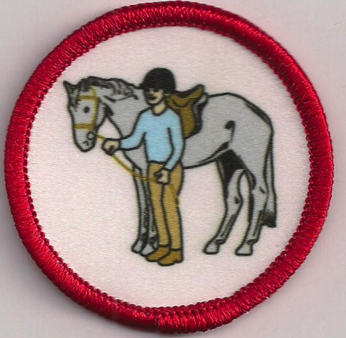
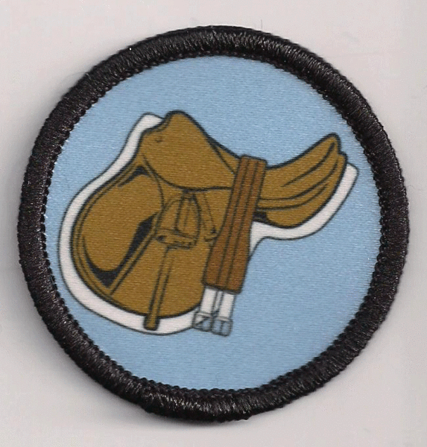
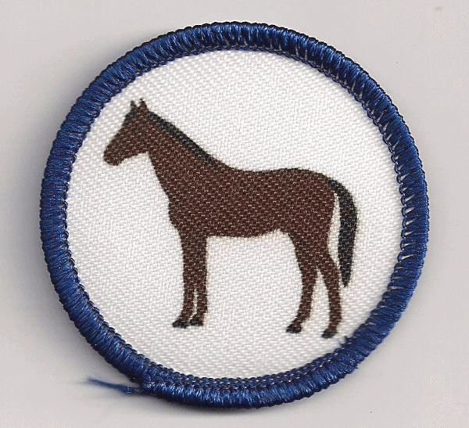
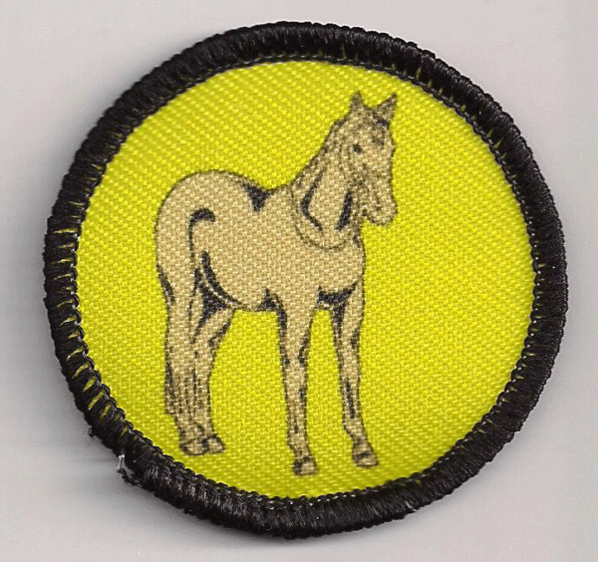
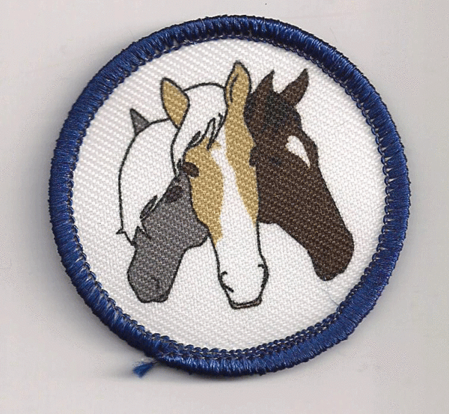
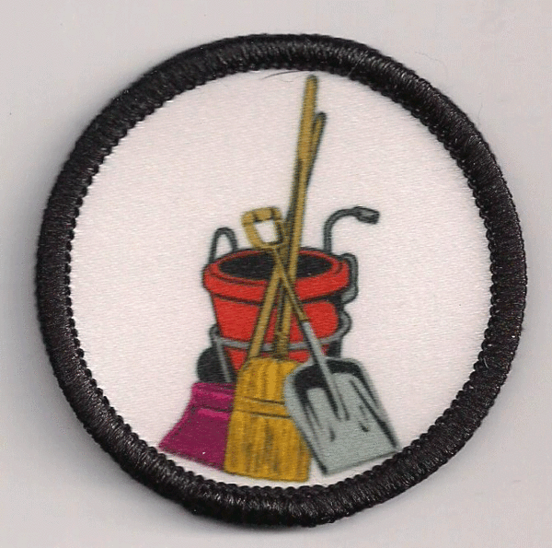
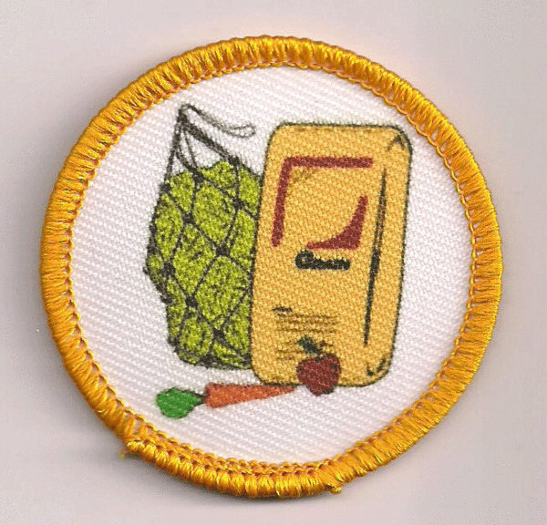
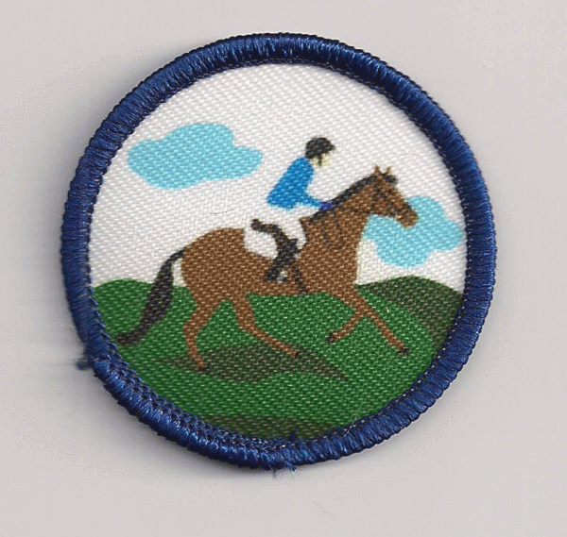
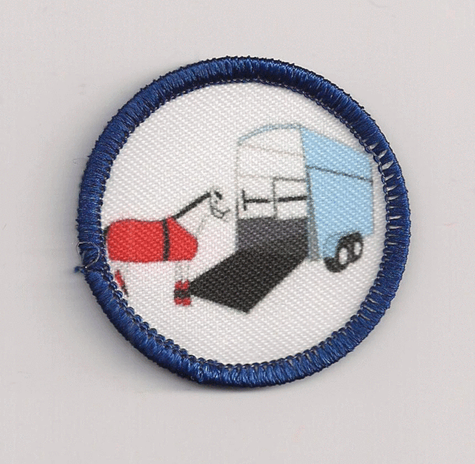
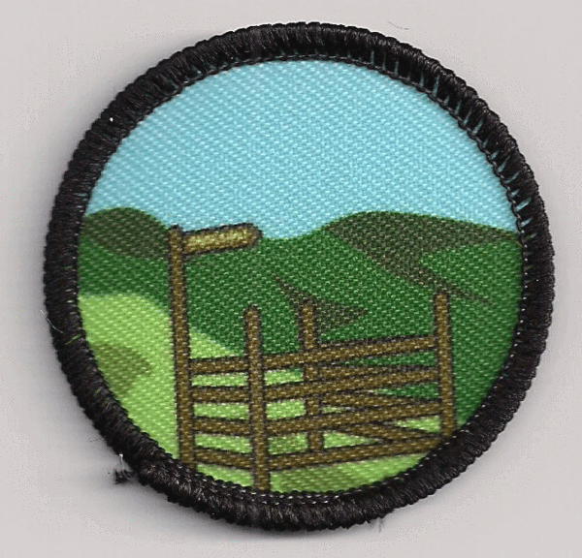
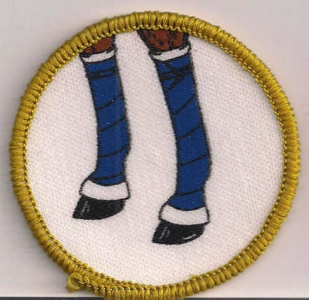

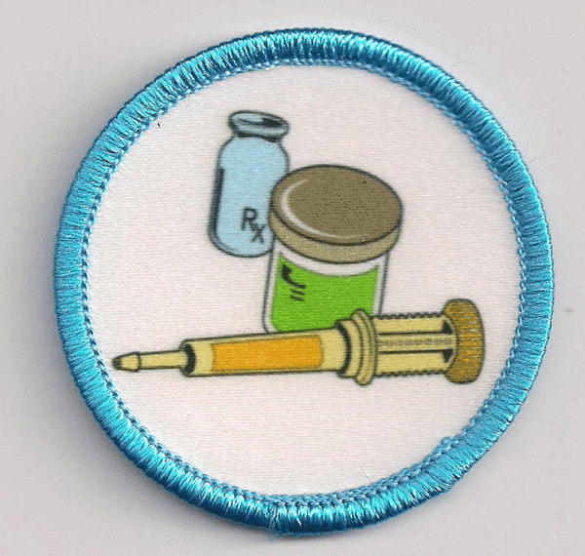
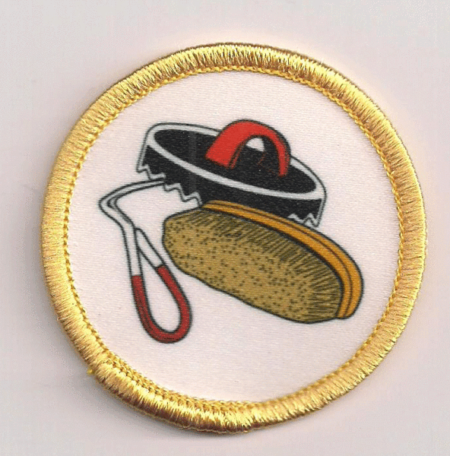
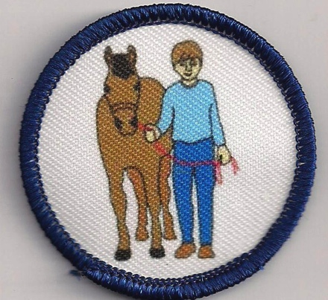
Horse Management Badge Program

Slide 7

MPC Mounted Meetings
2
Riding Instruction

Slide 8
Goals of Mounted Education
Preparing for Certification
Preparing for Rallies
Exposure to Great Clinics
Improve Riding Skills

Slide 9
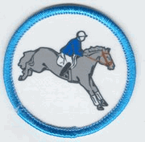

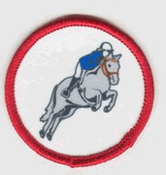

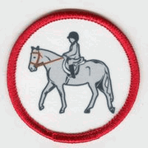
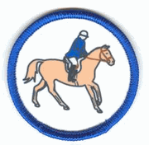
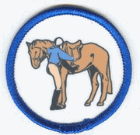
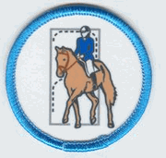
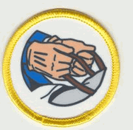
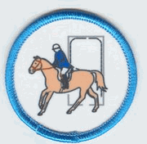
Riding Skill Badge Program

Slide 10
Meeting Structure
Held at different locations in our area
We bring in subject matter experts and riding clinicians
Unmounted education is free
Mounted education – depends on instructor, cost typically divided between members. Fundraising can help offset those costs.
Upper level members mentor/teach younger members

Slide 11
MPC Rallies & Certifications
3
Show Off What You’ve Learned

Slide 12


CERTIFICATIONS

Slide 13

What is Certification For?
The United States Pony Clubs, Inc., establishes Standards of Proficiency within the framework of the international Pony Club movement as the educational curriculum for a program of instruction and evaluation of its members for certifications in three primary areas: Horse Management, On the Flat, and Over Fences. The USPC Standards of Proficiency provide a core curriculum for individualized instruction. The Standards describe a clear progression of skills in riding and Horse Management. The Standards also provide opportunities for goal setting, as members are encouraged to proceed through those skills at a pace that is comfortable for them.
Pony Club Certification

Slide 14
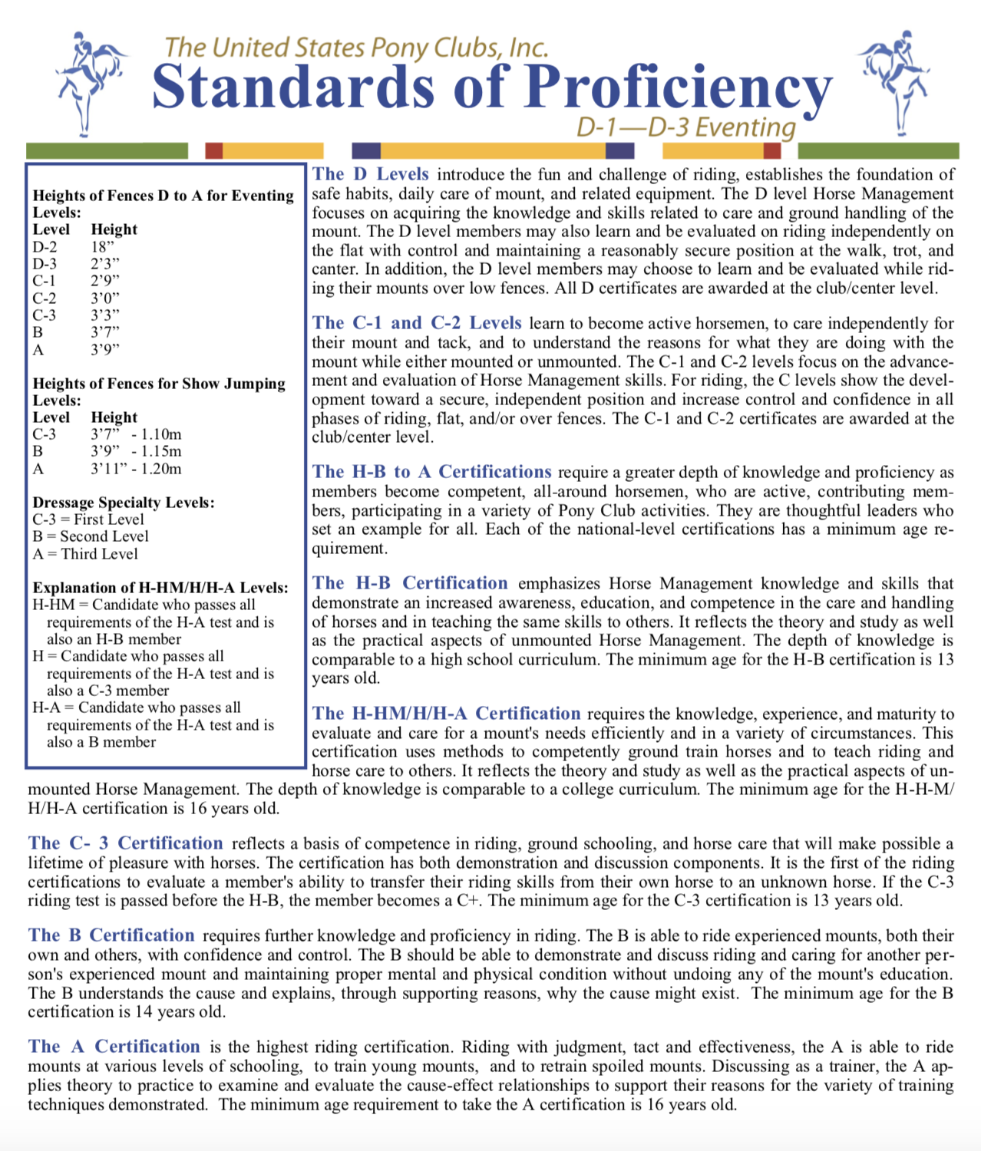

Slide 15
D1
D2
D3
C1
C2
HB
C3
HA
B
A

Slide 16
Chart of Learning

Slide 17

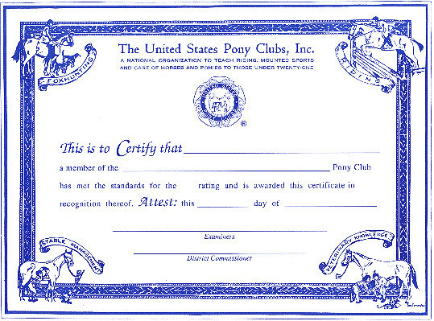
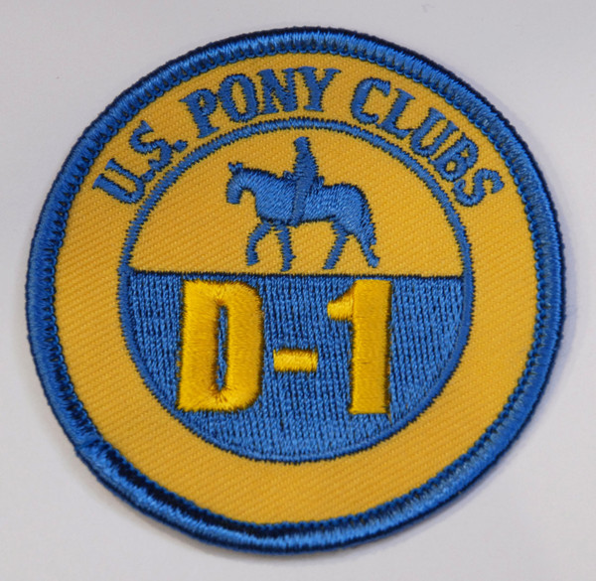
MPC Certifications
MPC will offer 2 Certifications each year. One in the Spring and one in the Fall.
Spring will be focused on new members obtaining their D1 Certification
Fall will be focused on existing members progressing
Both are open to anyone who wants to certify at the next level

Slide 18
Rallies

Slide 19
Rallies – Hosted by the Region
A Rally is two parts
  Horse management
  Riding Discipline (dressage, eventing, show jumping, etc.).
Riders are judged not only in their discipline like a regular show, but they are also judged on their horse management knowledge/skills based on their Certification Level (D-1, D-2, D-3, C-1, C-2, etc) by horse management judges.

Slide 20

Resources
Adrienne Sipe – DC
678-777-7123
Sipe.ponyclub@gmail.com
https://milton.ponyclub.org
https://south.ponyclub.org
https://ponyclub.org
https://www.facebook.com/MiltonPonyClubGA
https://www.facebook.com/groups/miltonpc/

